Slide 1
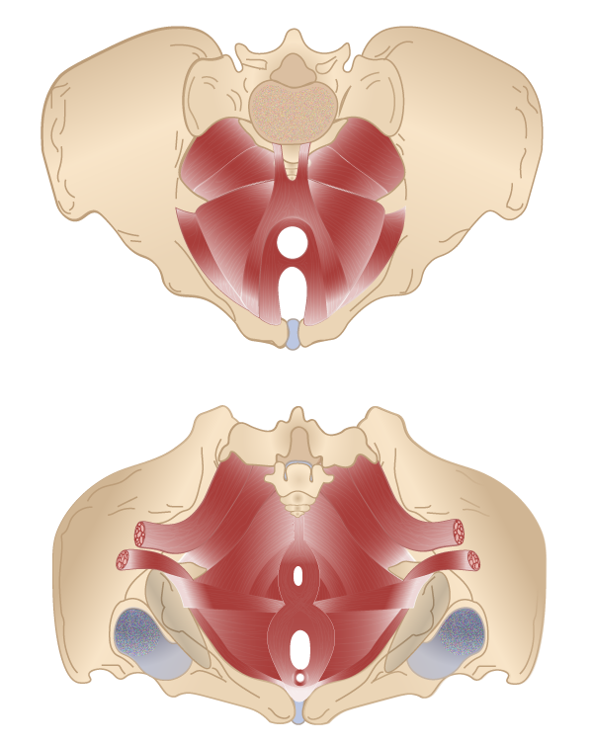
An Exercise in Awareness...
23% of mesh patients polled following mesh surgery had never been offered conservative treatment
Many offered mesh for mild incontinence
Pelvic Floor Muscle Training is proven to be an effective treatment for SUI
PFMT significantly improves QoL
https://www.ncbi.nlm.nih.gov/pubmed/29844662

Slide 2
A Permanent Problem
Neither risks nor permanence are communicated
Complications typically arise between 30 days and 5 years
Examples in mesh community of issues arising much later
Largest ever study of ∼98K women found 9,8% experience complication following SUI mesh
1:10 is too High!!
Impact to QoL is dramatic
https://www.nature.com/articles/s41598-017-11821-w

Slide 5
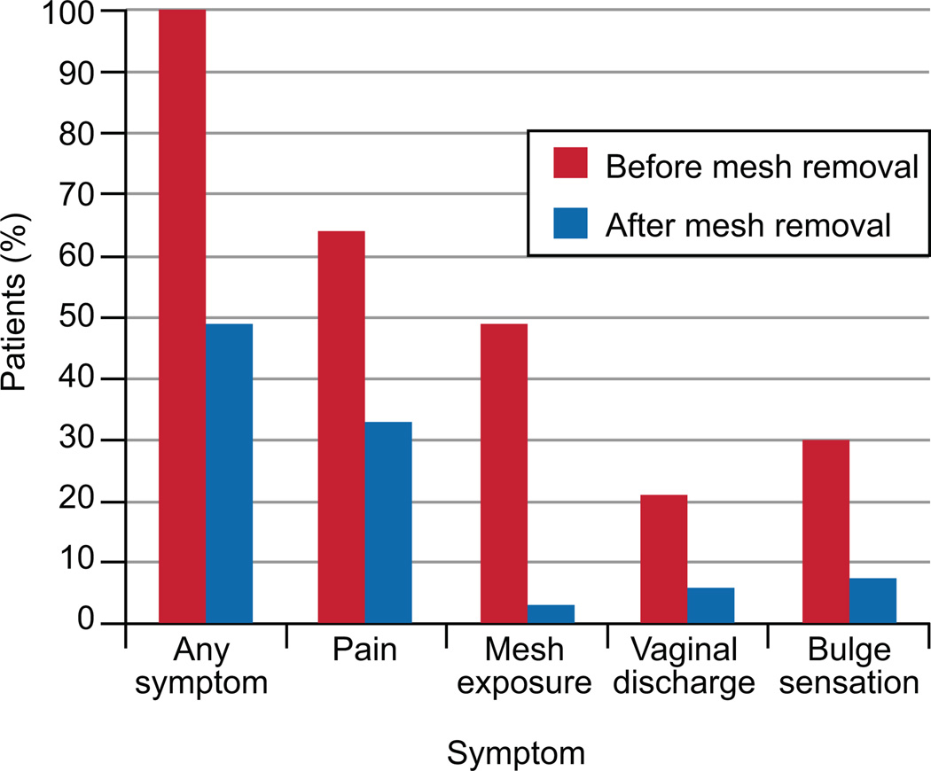
Life after removal
Pain resolves in approx. half cases following removal
Risk of POP increased
Incontinence can be severe, even if originally mild
Patients should be informed
prior to implantation!
https://www.ncbi.nlm.nih.gov/pmc/articles/PMC4055867/

Slide 6
Change is needed
Risks have been known since 1995
Corruption in study data due to financial conflicts of interest
Bigger problem than just mesh – even Cochrane
See Nov 8th release on BMJ – Peter C Gøtzsche (founding member)
We believe YOU are part of the solution
https://blogs.bmj.com/bmj/2018/11/08/peter-c-gotzsche-cochrane-no-longer-a-collaboration/

Slide 7
Vad vill vi?
Moratorium. Utredning om säkerhet.
Fler fysioterapeuter inriktade på bäckenbotten.
Prolaps- och inkontinensnät endast som sista utväg.
Diskussion om ALLA alternativ.
Bättre information om samtliga risker före operationen.
Genuint informerat samtycke.
Långsiktig uppföljning. Bättre enkäter.

Slide 8
Vad vill vi?
Spårbarhet. Register/databas. Streckkoder. Diagnoskoder.
Läkare som kan avlägsna nät.
Tidigare kirurgiska metoder – väck liv i kunskaperna.
Anmäl till IVO och LMV.
Patienter måste få möjlighet att anmäla vårdskador till IVO igen.
Gör det enklare för patienter att anmäla medicintekniska produkter till LMV.
Lyssna på oss. Tro oss. Och hjälp oss.

Slide 10
Questions?
Thank you for taking the time to listen 😊

